Slide 1

Data Structures and Sorting Algorithms visualization tool
by
Anoop Tripathi – 2401EC16
Shashank Mishra – 2401E36

Slide 2
What are Data Structures and Algorithms? Data structures are ways to organize and store data efficiently, while algorithms are step-by-step methods for solving problems or performing tasks.
Why are they important ? They are the backbone of computer science, enabling faster data processing, optimized memory usage, and better program efficiency.
Applications:
Search engines (e.g., Google) rely on sorting algorithms and graph structures.
Social media platforms use data structures to manage user data and connections.
Games implement algorithms for pathfinding, AI behavior, and resource management.
HERE COMES EASY VISULISATION FOR BETTER UNDERSTANDING !!!

Slide 3
OUR PROJECT
DATA STRUCTURES
ALGORITHMS
LINEAR
NON LINEAR
BUBBLE SORT
LINKED LIST
QUEUE
STACK
BST
INSERTION SORT
SELECTION SORT
USING ARRAY
USING ARRAY
AVL
HEAP SORT
USING LINKED LIST
USING LINKED LIST
GRAPH
MERGE SORT

Slide 4
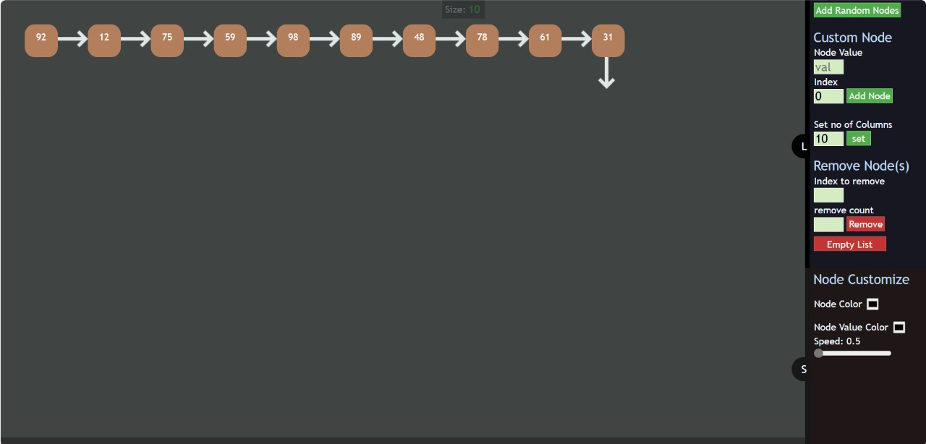
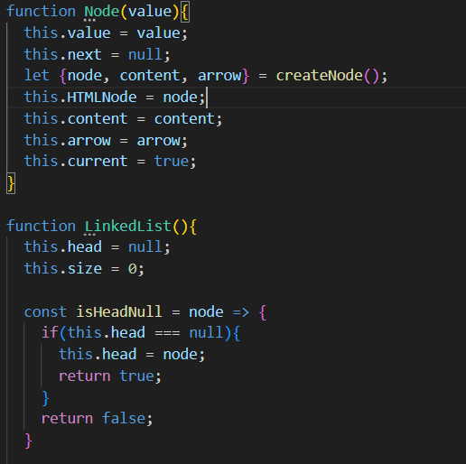
Introduction to Linked List:
A linked list is a linear data structure where elements, called nodes, are connected using pointers.
Each node contains:
Data: The value stored in the node.
Next: The reference to the next node in the list.
Logic used : html ,css for styles and animation and javascript for nodes formation, deletion, other logics

Slide 5
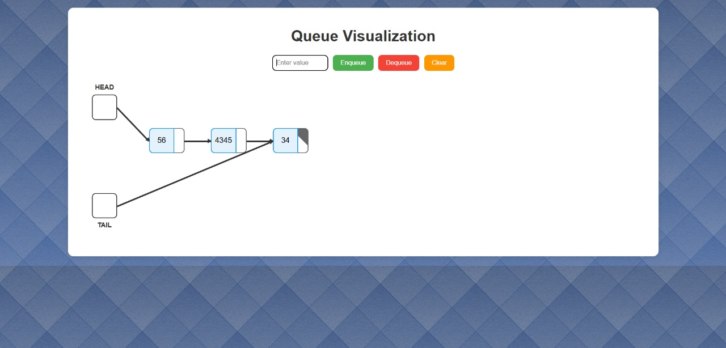
Queue Using Linked List Concept: A dynamic structure where nodes are linked together. Each node contains: * Data: Value stored in the node. * Next: Pointer to the next node. * Implementation Steps: Use JavaScript classes to represent nodes and the queue. Dynamically enqueue and dequeue nodes.
Queue Using Array
Concept: A static structure implemented using a fixed or resizable array. Operations:
Enqueue: Add an element at the end of the array.
Dequeue: Remove an element from the front.
Implementation Steps:
Maintain an array to store elements.
Use JavaScript methods to add/remove elements.

Slide 6
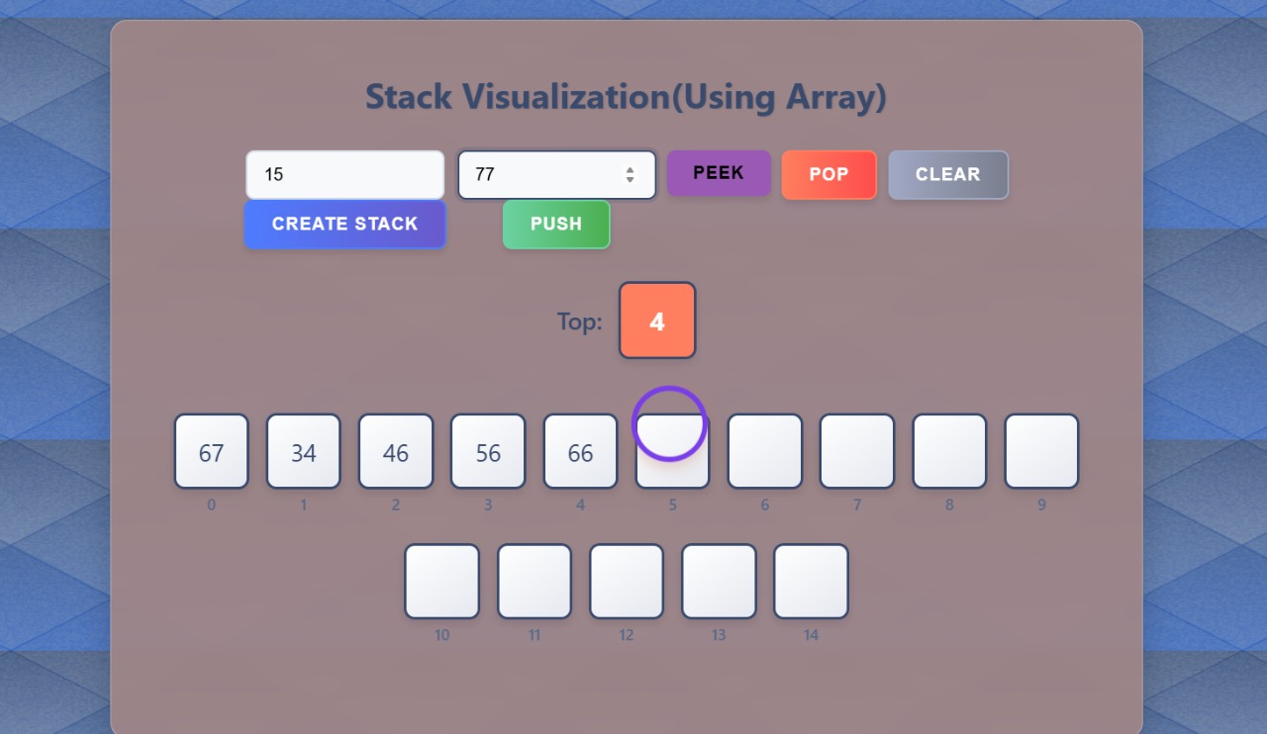
Stack Using Linked List Concept: A dynamic stack where each element is stored as a node. Each node contains: Data: The value. Next: Pointer to the next node in the stack. Implementation Steps: Use JavaScript classes to represent nodes and the stack. Perform push and pop operations dynamically.
Stack Using array
Concept: A static stack implemented using an array. Operations:
Push: Add an element to the top of the stack.
Pop: Remove the element from the top of the stack.
Implementation Steps:
Maintain an array to store elements.
Use JavaScript methods to perform stack operations.

Slide 7
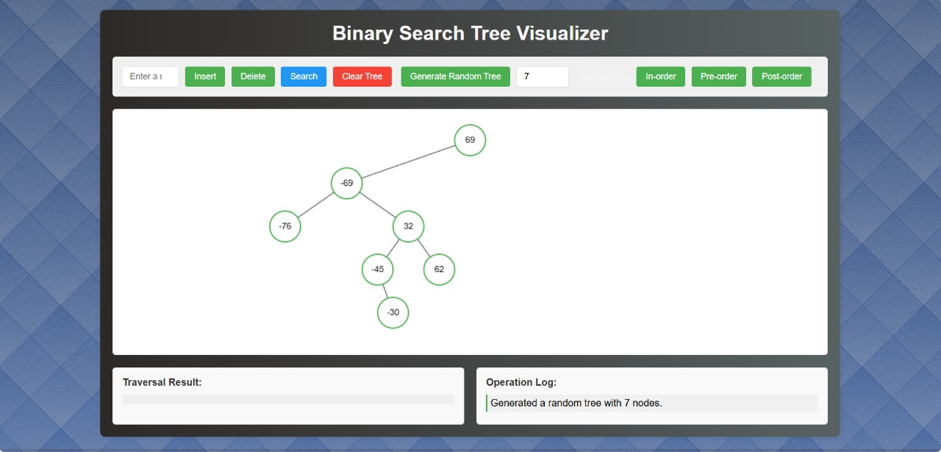
Binary Search Tree: A BST is a hierarchical data structure where each node has at most two children, and: Left Subtree: Contains nodes with values less than the parent node. Right Subtree: Contains nodes with values greater than the parent node.
Dynamic creation and deletion of nodes are implemented using js logics while ensuring the property of bst !!
Here the feature of preorder , inorder , postorder are implemented enhanching learners experience and understanding..
Time complexity:
Best case: O(log n) (balanced tree).
Worst case: O(n) (skewed tree).

Slide 8
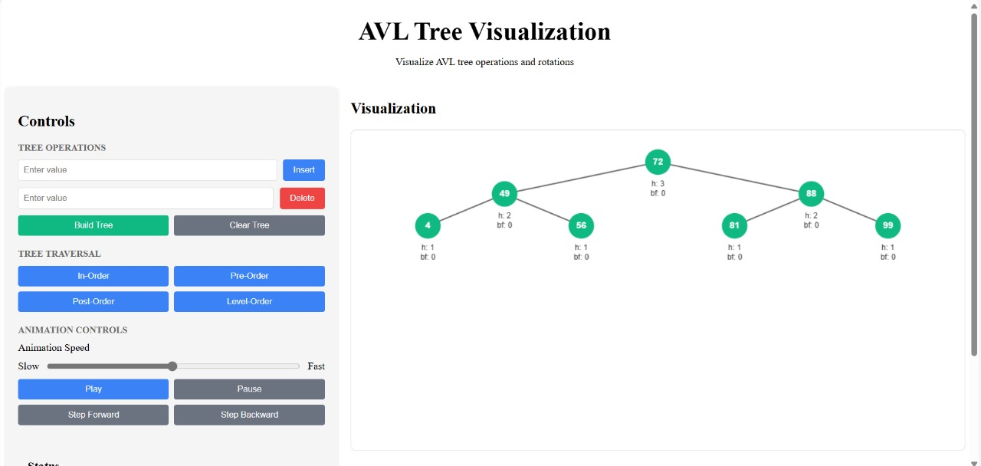
AVL TREE : An AVL tree is a self-balancing binary search tree (BST) where the balance factor (difference between heights of left and right subtrees) for every node is either -1, 0, or 1. we ensured the dynamic and swift left , right , LR , RL rotations for ensuring the properties of AVL tree !!
LOGIC USEd : dynamic creation deletion of nodes ,calculation of balance factor and required rotations using javascript !!
Swift animations for better beginner understanding …

Slide 9
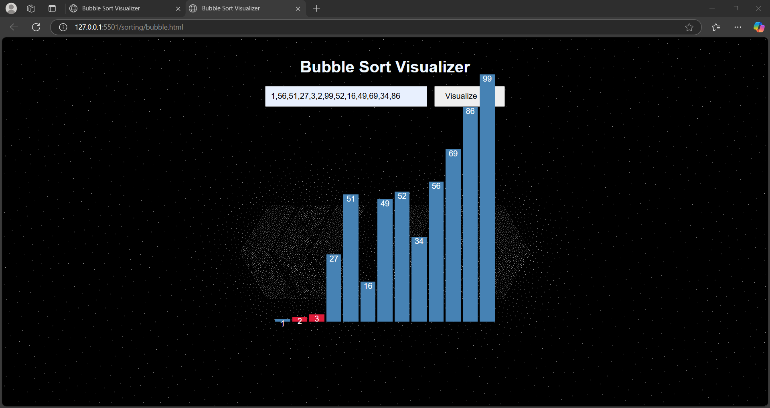
Sorting algorithms we have made visualizers for the following sorting algorithms by detailed comparisons and self explanatory animations using java script logics
Bubble sort : Bubble Sort Content: Concept: Repeatedly swaps adjacent elements if they are in the wrong order. A simple but inefficient algorithm. Steps: Compare each pair of adjacent elements. Swap them if they are in the wrong order. Repeat for all elements until no swaps are needed. Time Complexity: O(n²).

Slide 10
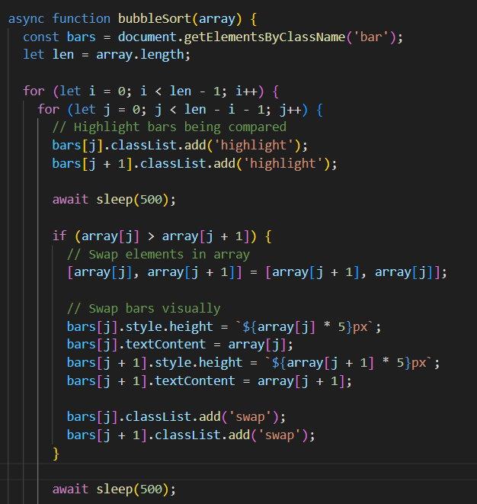
Bubble sort : Bubble Sort Content: Concept: Repeatedly swaps adjacent elements if they are in the wrong order. A simple but inefficient algorithm. Steps: Compare each pair of adjacent elements. Swap them if they are in the wrong order. Repeat for all elements until no swaps are needed. Time Complexity: O(n²).

Slide 11
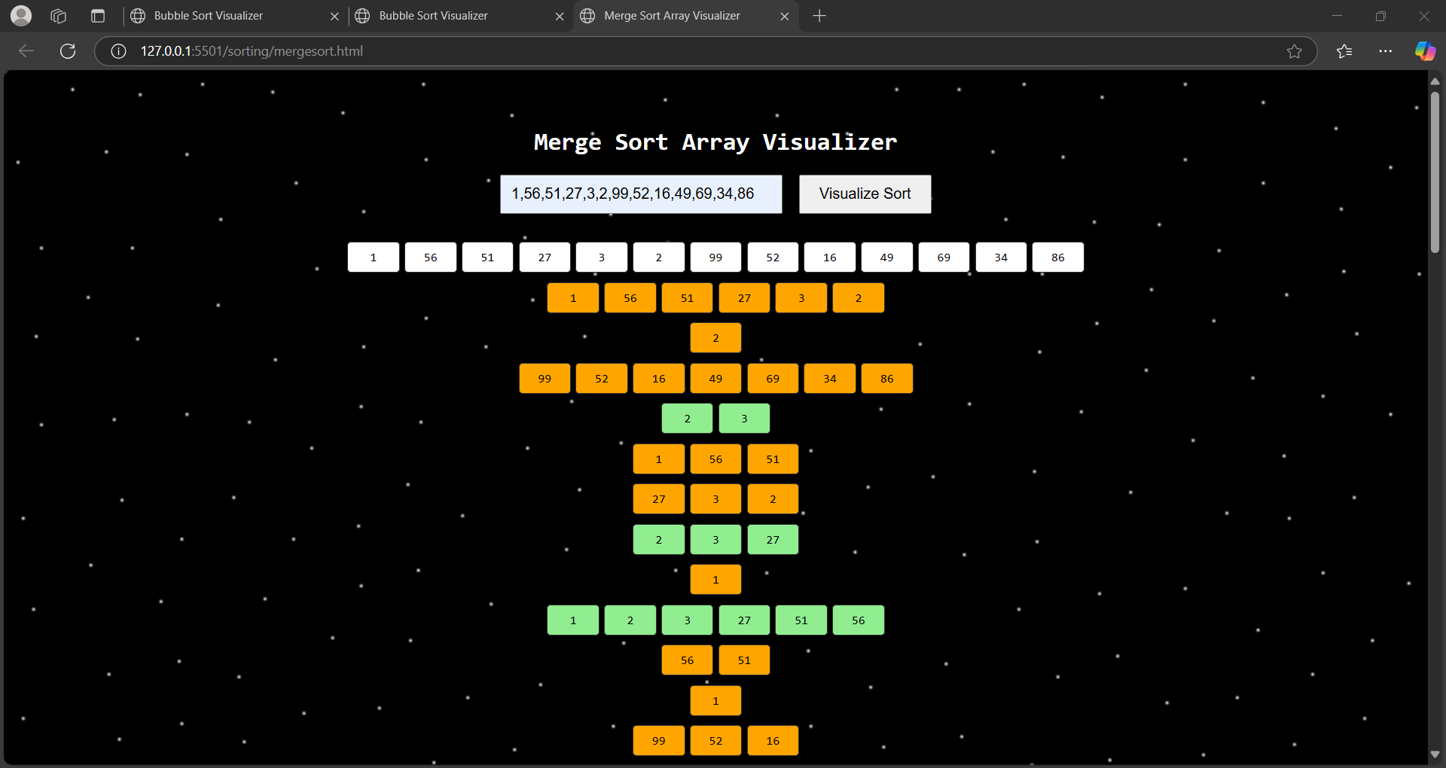
Merge Sort Concept: A divide-and-conquer algorithm. Splits the array into halves, sorts them, and merges the sorted halves. Steps: Divide the array into two halves. Recursively sort each half. Merge the two halves into a sorted array. Time Complexity: O(n log n).

Slide 12
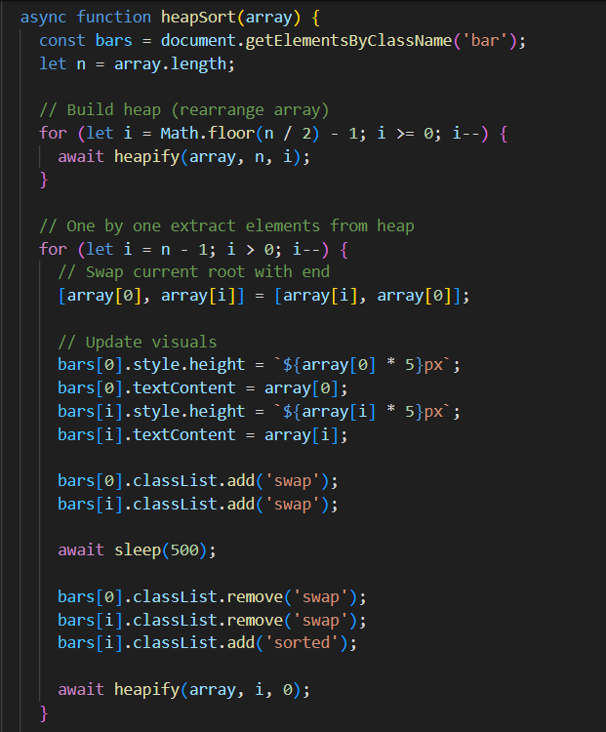
Heap Sort Concept: Uses a binary heap to sort elements. Builds a max-heap and repeatedly extracts the maximum element. Steps: Build a max-heap from the input array. Extract the maximum element repeatedly and reduce heap size. Time Complexity: O(n log n).

Slide 13
Insertion Sort Concept: Inserts elements one by one into their correct position. Similar to how you sort playing cards in your hand. Steps: Start with the second element and compare it with previous elements. Shift larger elements to the right. Insert the current element in its correct position. Time Complexity: O(n²).
Selection Sort Concept: Selects the smallest element from the unsorted part and swaps it with the first element of the unsorted part. Steps: Find the minimum element from the unsorted array. Swap it with the first element of the unsorted part. Repeat until the entire array is sorted. Time Complexity: O(n²).

